Slide 1
STRUCTURAL STEEL AND SECTIONS
Steel
Steel is an alloy of iron and carbon and other elements e.g. silicon(0.3-0.4%),phosphorous(0.12%) and sulphur(0.02-0.10%).
I

Slide 2
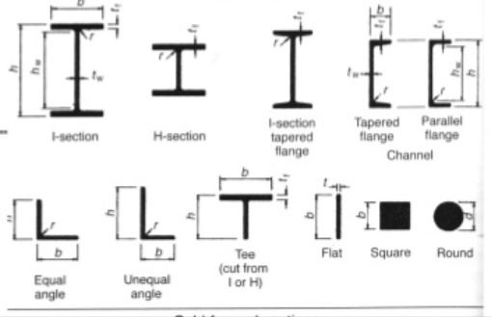
Structural steel sections
· Structural steel is a category of steel used for making construction materials in a variety of shapes. .
Angle section
I- sections or Beam sections
Channel sections
Tee sections
Rolled steel bars
Rolled steel flats/plates/sheets
Rolled steel tubes

Slide 3
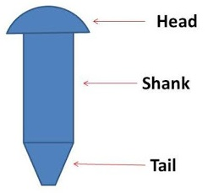
RIVETED CONECTIONS
Rivet
A rivet is a permanent mechanical fastener. Before being installed, a rivet consists of a smooth cylindrical shaft with a head on one end. The end opposite to the head is called the tail.

Slide 4
TYPES OF RIVETS DEPENDING UPON THE SHAPE OF THEIR HEADS

Slide 5
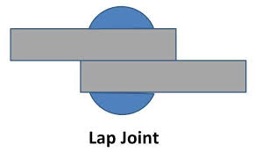
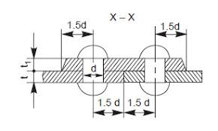
TYPES OF RIVETED JOINTS
1.Lap joint
A lap joint or overlap joint is a joint in which the members overlap. Lap joints can be used to join wood, plastic, or metal.
2.Butt joint
A butt joint is a technique in which two pieces of material are joined by simply placing their ends together without any special shaping.

Slide 6
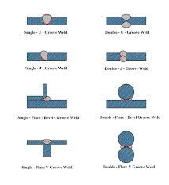
WELDED CONNECTIONS
Two types of welds.
1. Butt weld

Slide 7
Filled weld(lap weld)

Slide 8
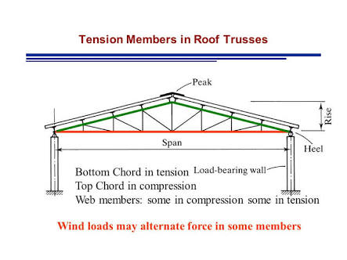
TENSION MEMBER
Tension members are structural elements that are subjected to axial tensile forces.

Slide 9
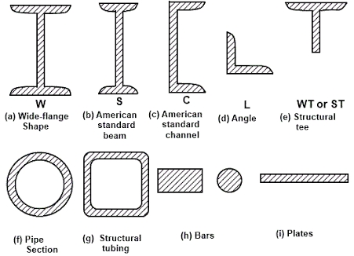
Forms of Tension Members
Wires and cables,
Rods and bars
Single structural shapes and plates
Built-up members

Slide 10
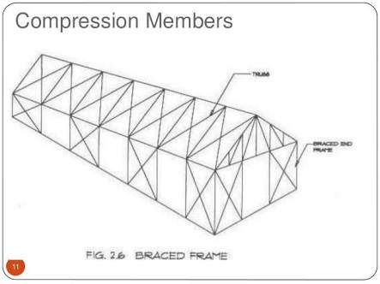
COMPRESSION MEMBERS(STRUTS)
Compression members are structural elements that are pushed together or carry a load, more technically they are subjected only to axial compressive forces.

Slide 11
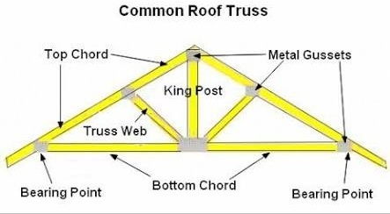
ROOF TRUSS
Truss
Roof trusses are characterised by an economic use of construction materials (timber, steel).

Slide 12
TYPES OF TRUSSES

Slide 13
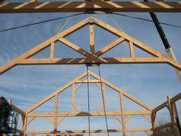
Simple fink truss

Slide 14
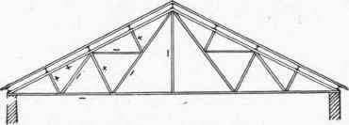
Compound fink truss

Slide 15
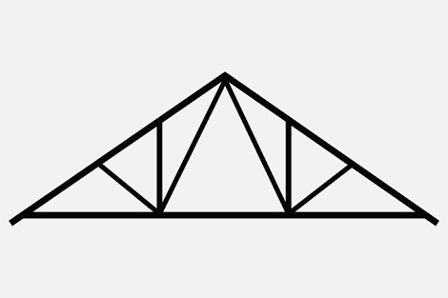
Simple Fan truss

Slide 17
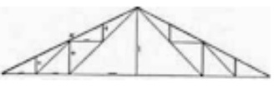
Compound fan truss

Slide 18
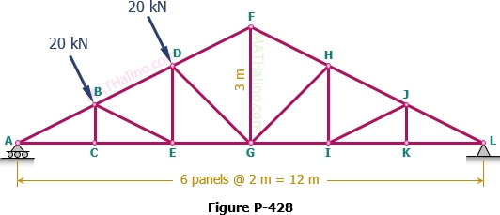
Howe Truss

Slide 19
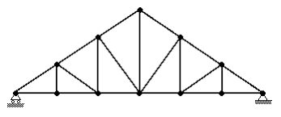
Pratt truss

Slide 20
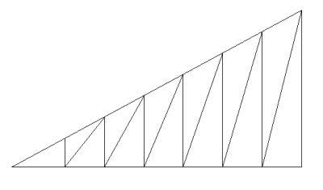
North light truss

Slide 21
Connection between purlin and roof covering

Slide 22
Roof covering G.I. sheets

Slide 23
Asbestos Cement sheets

Slide 24
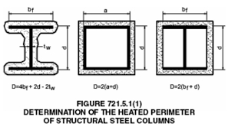
COLUMNS
Steel frame is a building technique with a "skeleton frame" of vertical steel columns

Slide 25
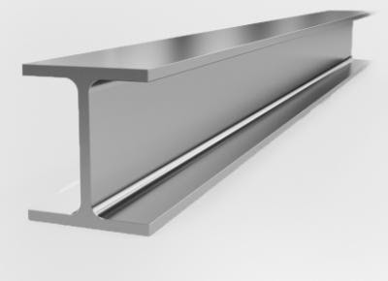
BEAMS
Steel beam is a structural steel product that is made to support heavy loads

